Slide 1

WELCOME
COHORT 5
7th Sept – 3rd Dec 2026
Suite 6-6-7, Level 6, Menara MAA

Slide 2
Introduction to Client-Side Routing
What is Client-Side Routing?
Navigation between different views without full page reloads
JavaScript manages URL changes and renders appropriate components
Provides SPA (Single Page Application) experience
Maintains browser history and back/forward functionality

Slide 3
Introduction to Client-Side Routing
Traditional vs Client-Side Routing:
Traditional Routing:
/home → Server renders home.html
/about → Server renders about.html
/contact → Server renders contact.html
Client-Side Routing:
/home → React renders <Home /> component
/about → React renders <About /> component
/contact → React renders <Contact /> component

Slide 4
Introduction to Client-Side Routing
Benefits of Client-Side Routing:
Faster navigation (no full page reloads)
Better user experience with smooth transitions
Shared state between routes
Reduced server load
Mobile app-like experience

Slide 5
Install React Router
Create React App with Vite
# Create new React project
npm create vite@latest react-router-navigation -- --template react
# Navigate to project
cd react-router-navigation
# Install dependencies
npm install
# Install react router
npm install react-router-dom
Notes:
install dependencies

Slide 6
Structure Overview
Router - The top-level wrapper component that enables routing functionality for your entire application
NavLink - A special Link component that adds styling attributes to the rendered element when it matches the current URL, perfect for navigation menus.
Routes - A container component that groups multiple Route components.
Route - Defines a mapping between a URL path and a React component, specifying what component should render when the path matches.

Slide 7
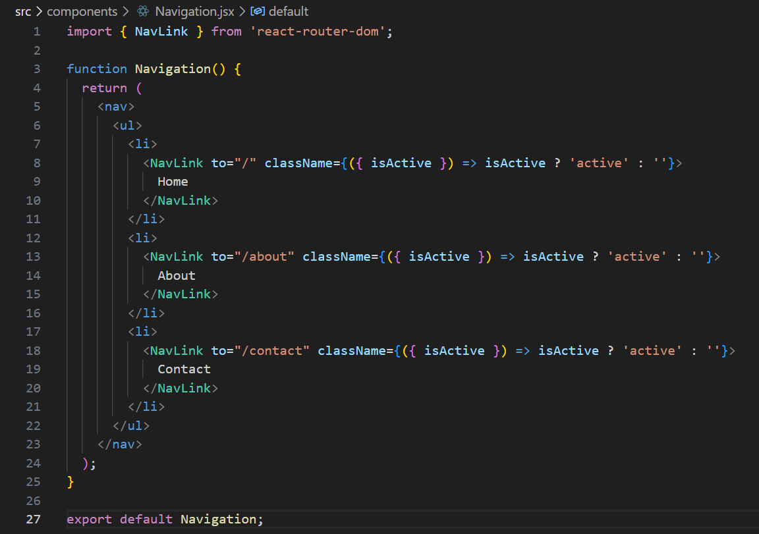
NavLink
Active state management - automatically apply active styling when current route matches the link

Slide 8
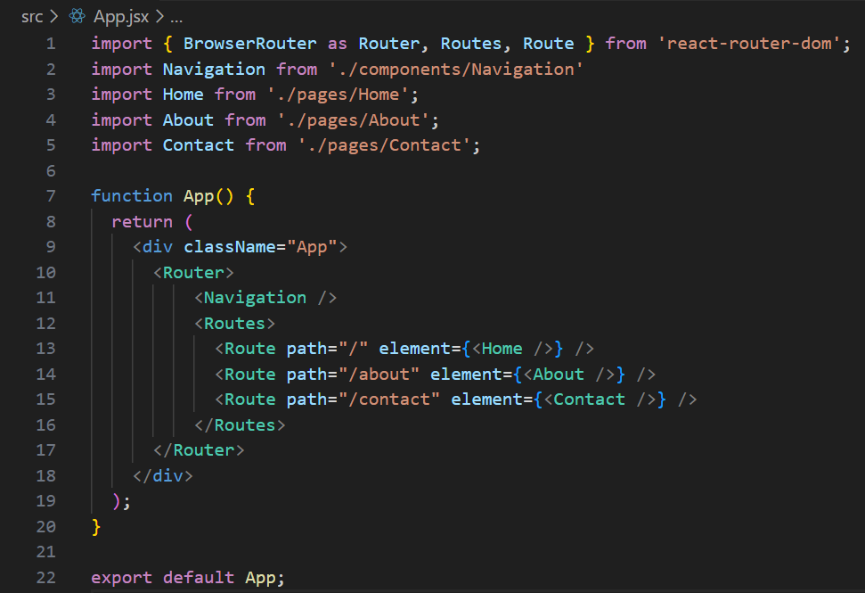
Setup routes
Create “pages” folder, then create dummy files for the respective page Routes.
When current url matches the path, it will render the element.
Refer to presenter’s note.
Notes:
//example About component from pages folder
function About() {
return (
<div >
<h1>About Us</h1>
<p>
We are a team of passionate developers dedicated to creating amazing web
experiences. Our mission is to build software that is not only
functional but also beautiful and easy to use. Learn more about our
journey and the people behind the code.
</p>
</div>
);
}
export default About;

Slide 9
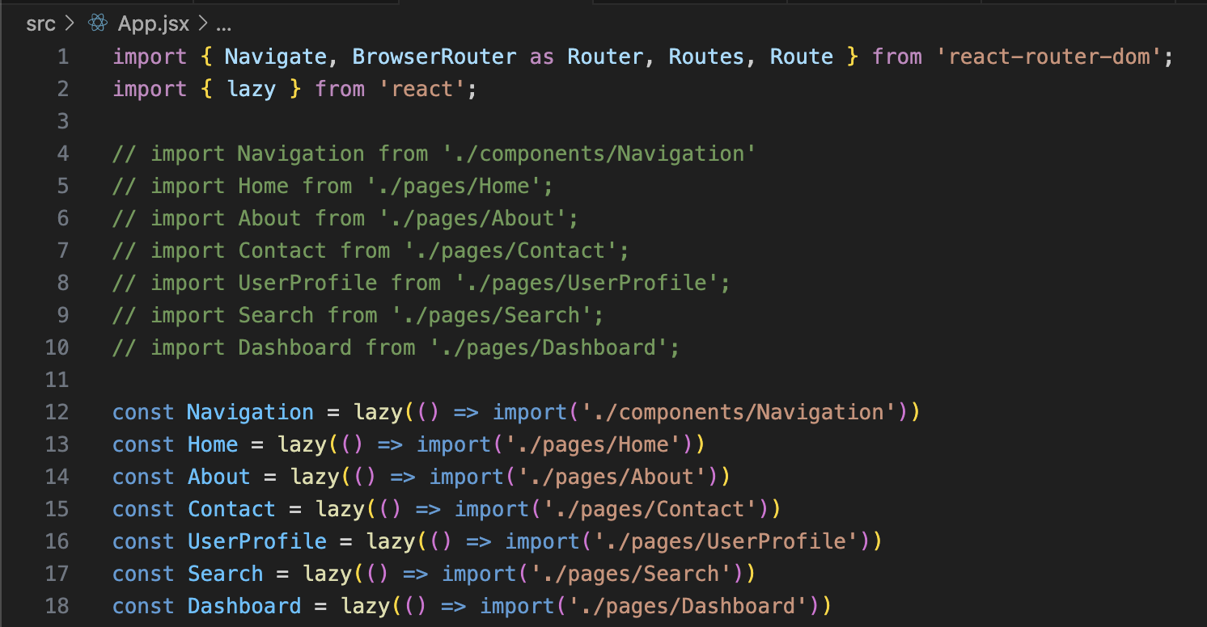
Setup routes - Tips
For better rendering performance, you may use LazyLoading when importing pages.
Lazy will only import the specific pages, when it’s called.
Meanwhile, the original import will import all pages together during first load.

Slide 10
Recap of React Router Basics
The basic for routing in React are the following:
Router
NavLink
Routes
Route

Slide 11
URL Parameter
Route parameters - are part of the URL path itself (e.g., /users/:id where :id is a route parameter/dynamic placeholder)
  Usually represent required data to identify resources
Query strings - are key-value pairs that come after the ? in a URL (e.g., /users?page=1&limit=10)
  Usually represent optional parameters for filtering, sorting, pagination

Slide 12
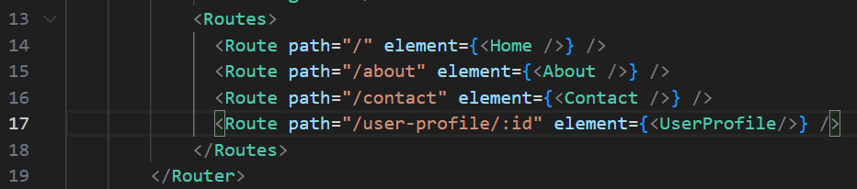
Route Parameter – App.jsx
Add the following into Route in App.jsx file
:id means it could be any value

Slide 13
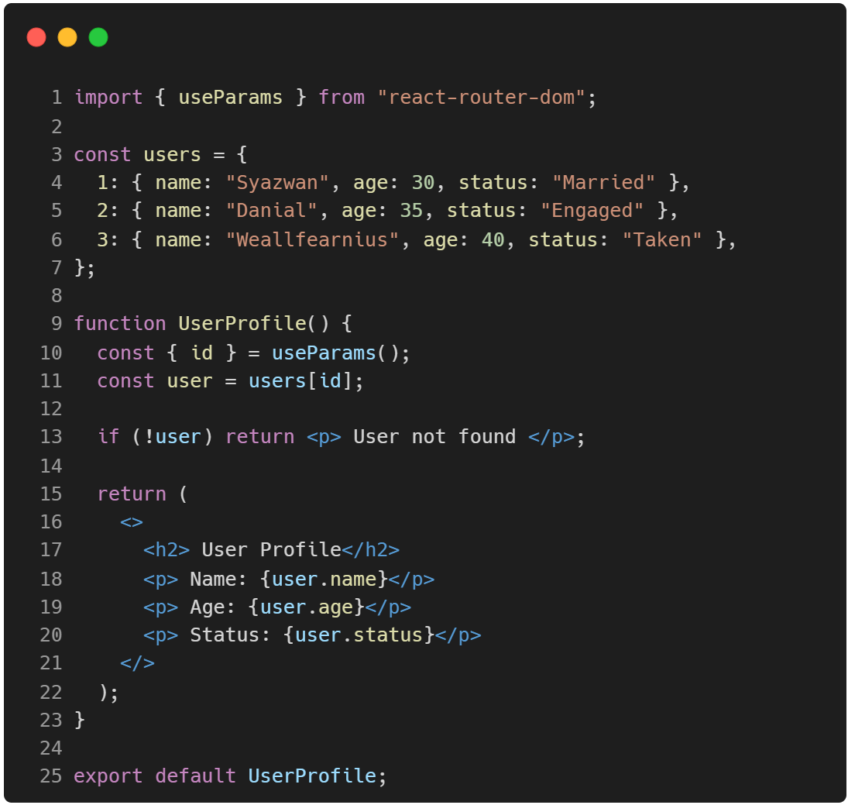
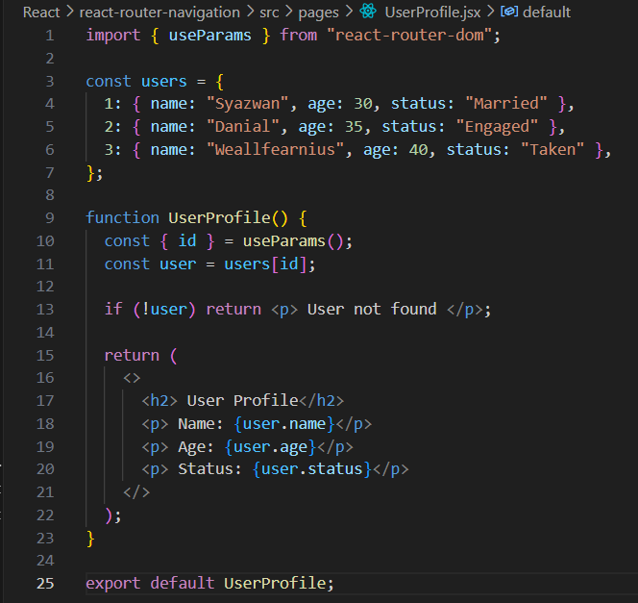
Route Parameter – UserProfile.jsx
In the UserProfile.jsx need to capture the parameter passed via URL by using useParams()

Slide 14
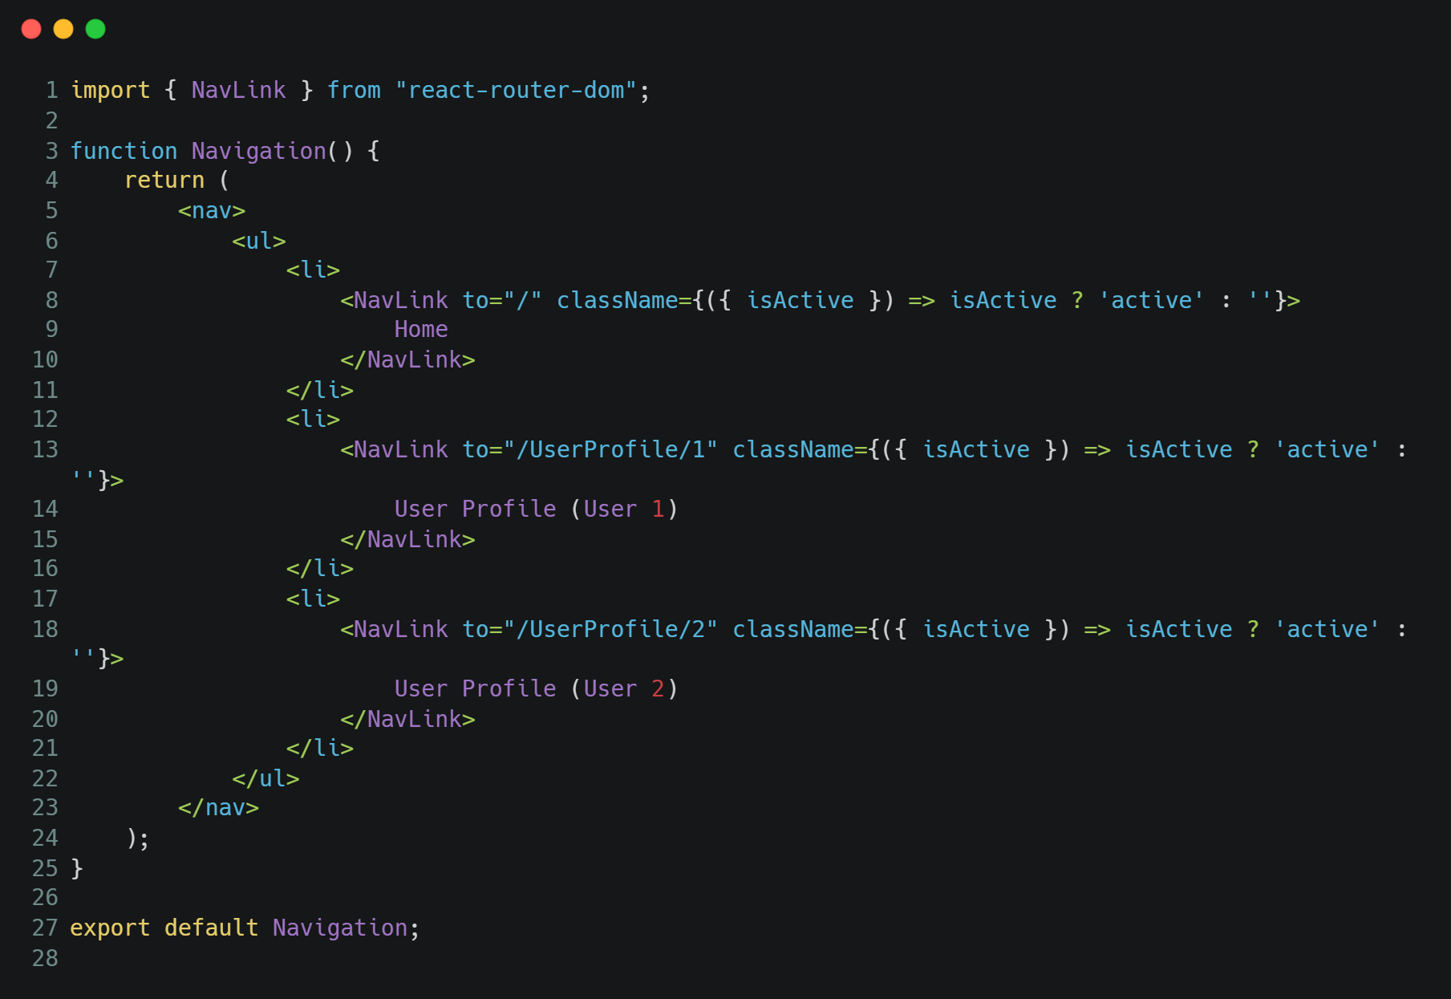
Route Parameter – Navigation.jsx
Add the relevant Navigation using NavLink for UserProfile route parameter.
Add as many user ID necessary but make sure to tally with the no of users ID in UserProfile page.

Slide 15
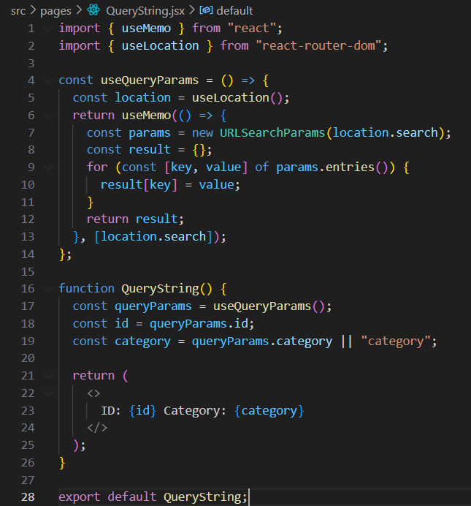
Query String
Line 19 is default value if category is not inside query string.
Think what and how to do Route path in App.jsx and NavLink in Navigation.jsx
Examples of NavLink for query string in presenter’s note.
Notes:
//add or modify below examples to your Navigation.jsx file to try out query string
<ul>
{/* Example 0 : Have ID and Category as keys, with respective values*/}
<li>
<NavLink
to="/user-profile?id=123&category=tech"
className={({ isActive }) => (isActive ? "active" : "")}
>
User Profile (ID 123, Tech)
</NavLink>
</li>
{/* Example 1: Different ID and Category */}
<li>
<NavLink
to="/user-profile?id=456&category=sports"
className={({ isActive }) => (isActive ? "active" : "")}
>
User Profile (ID 456, Sports)
</NavLink>
</li>
{/* Example 2: Another user and category */}
<li>
<NavLink
to="/user-profile?id=789&category=news"
className={({ isActive }) => (isActive ? "active" : "")}
>
User Profile (ID 789, News)
</NavLink>
</li>
{/* Example 3: Only an ID (category will be 'category' by default) */}
<li>
<NavLink
to="/user-profile?id=999"
className={({ isActive }) => (isActive ? "active" : "")}
>
User Profile (ID 999)
</NavLink>
</li>
{/* Example 4: Only a category (id will be undefined) */}
<li>
<NavLink
to="/user-profile?category=gaming"
className={({ isActive }) => (isActive ? "active" : "")}
>
User Profile (Gaming)
</NavLink>
</li>
</ul>

Slide 16
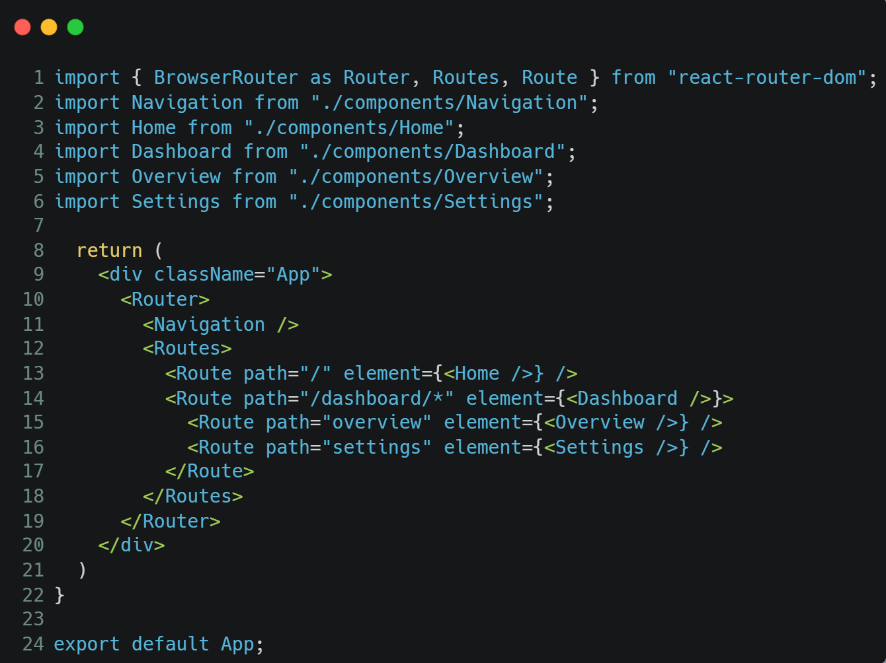
Nested Routing – App.jsx
Notice there is /* in line 14. It is expecting subpages inside dashboard.
Difference between Route Parameter is that Route Params is expecting a dynamic value/parameter while subpages using Nested Routing is saying that there are more pages inside this page.

Slide 17
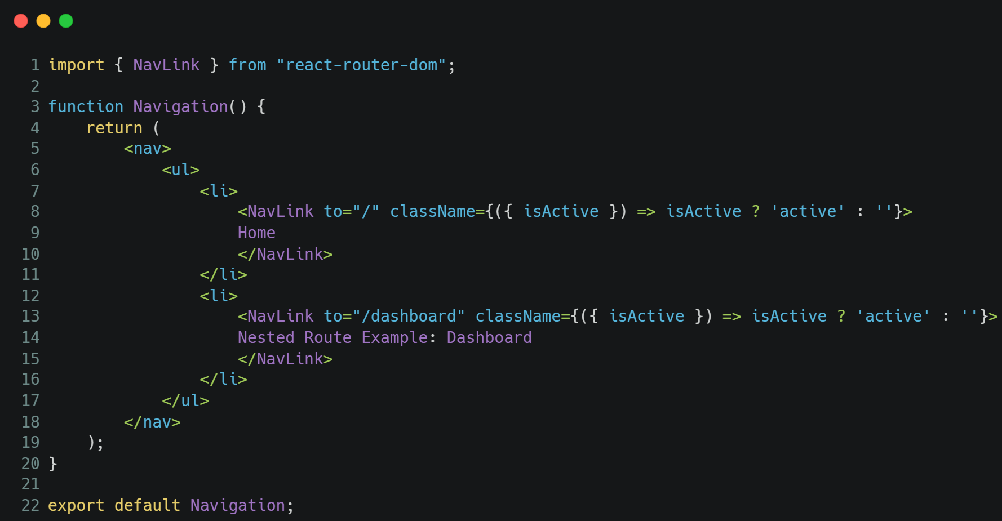
Nested Routing – Navigation.jsx

Slide 18
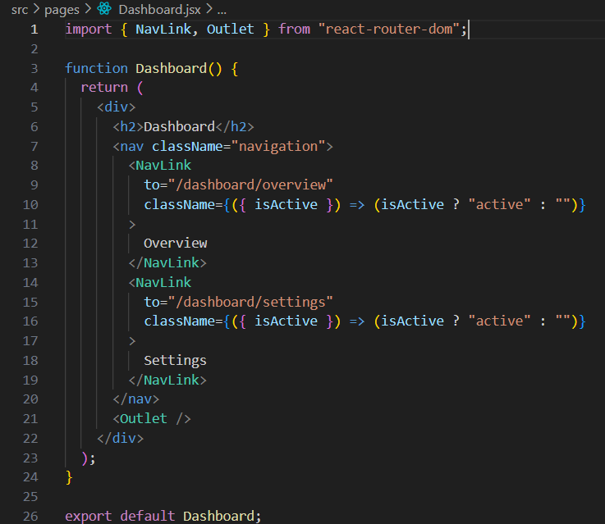
Nested Routing – Dashboard.jsx
<Outlet /> acts as the placeholder.
Without <Outlet />, child routes will not show up even if the URL matches.

Slide 19
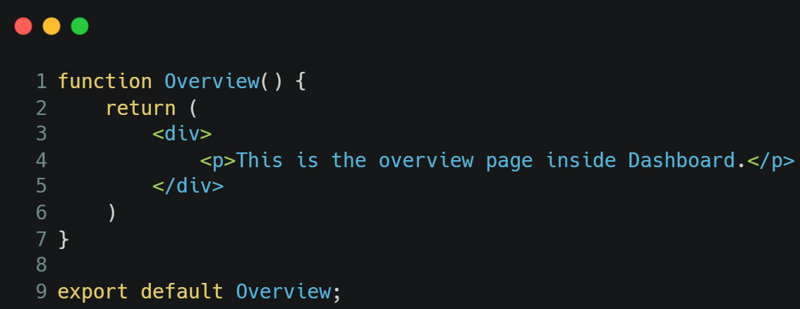

Nested Routing –
Overview.jsx & Settings.jsx
Create dummy Overview and Settings pages as above
OR
Change to your preferred pages to implement nested routing.

Slide 20
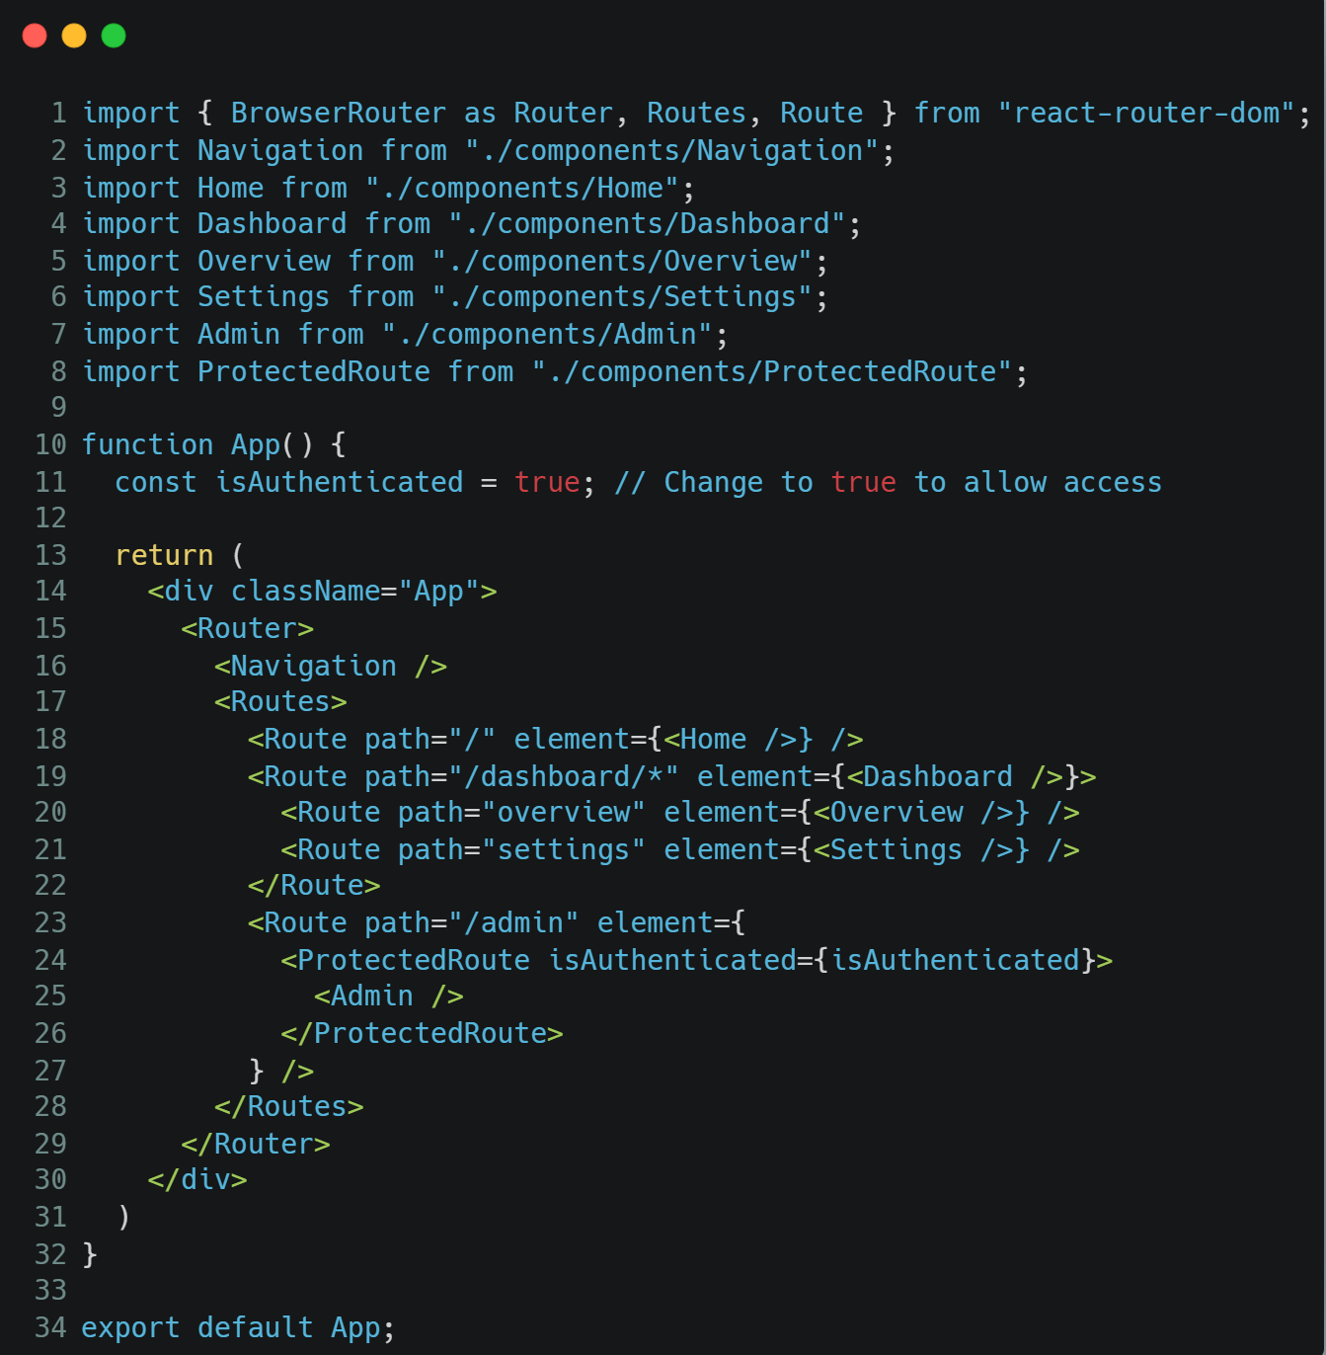
Protected Route – App.jsx
You can also pass in functional component in order to check if a person is authenticated to visit certain page/content.
Declare auth logic in line 11.
Setup Route path for admin with the declared logic parameter.

Slide 21
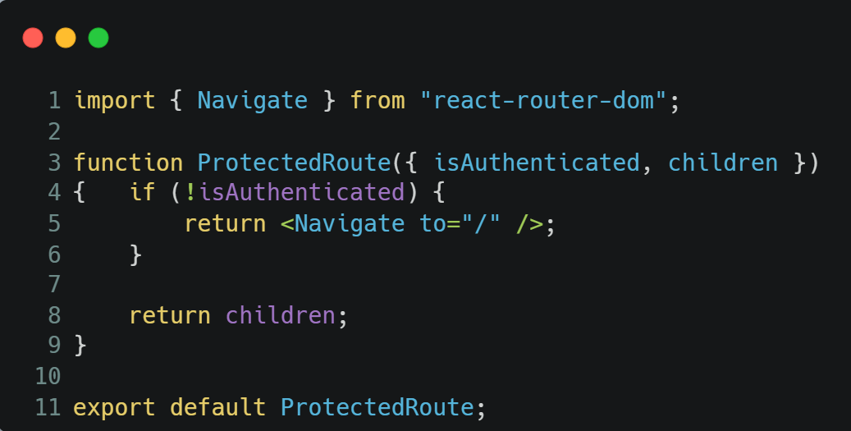
Protected Route – ProtectedRoute.jsx
Use Navigate from react router to direct to a default page when not authenticated.

Slide 22
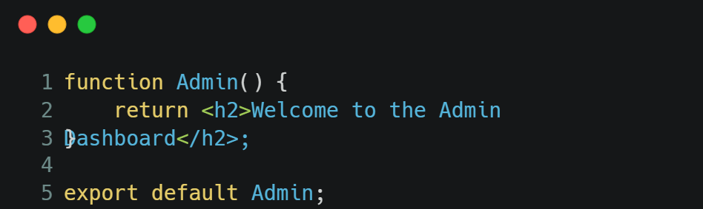
Protected Route – Admin.jsx
Create dummy Admin page as above
OR
Change to your preferred page to implement protected routing.

Slide 23
Key Learning Outcomes
By the end of this session, you will be able to:
✅ Client-side routing enables SPA navigation without page reloads
✅ Router wraps your app, Routes groups route definitions, Route maps paths to components
✅ NavLink provides active styling for navigation menus
✅ Client-side routing enables SPA navigation without page reloads
✅ Router wraps your app, Routes groups route definitions, Route maps paths to components
✅ NavLink provides active styling for navigation menus

